Slide 1




Analyzing the Sales of the Books on Amazon
A Case Study using SQL

Slide 2

Introduction to results analysis
This analysis is all about taking a closer look at the books available on Amazon. The dataset has the information on different types of genres, sub-genres, and individual books like their titles, authors, prices, and ratings. By digging into this data, we hope to give some interesting insights about what kinds of books are popular, how they're priced, and what people like to read. This can help us understand more about the world of books and what makes them tick on Amazon

Slide 3

About the Dataset
Title: The title of the book.
Author: Name of the author or publication house.
Main Genre: The main genre the book belongs to.
Sub Genre: The specific sub-genre of the book.
Type: Indicates the format of the book, such as paperback, Kindle, audiobook, or hardcover.
Price: The price of the book.
Rating: The average rating of the book given by users.
No. of People Rated: Indicates the count of users who have rated the book.
URLs: Provides the link to the book's page on Amazon for further details and purchase options.

Slide 4
Objective
Optimize Marketing Strategies
Analyze top-selling genres, authors, and book types to optimize marketing efforts. . Identify key demographics and preferences to tailor promotional campaigns effectively.
Enhance Product Offerings:
Use insights from book ratings and reader engagement to guide decisions on expanding the product offerings. Identify genres, sub-genres, and authors with high ratings and engagement to prioritize content acquisition and development.
Improve Customer Experience
Analyze customer ratings, feedback, and engagement metrics to identify areas for improving the overall customer experience. Enhance website features, product recommendations, and customer support services to drive customer satisfaction and loyalty.

Slide 5
Potential Insights
The potential insights from the dataset are as follows
Identify top-selling books.
Assess the diversity of authors
Explore pricing strategies across genres.
Recognize authors with high average ratings
Understand the distribution of book ratings
Identify books with high engagement
Assess the quality of highly-rated books
Identify bestselling authors by genre
Most preferred book type among kindle, paperback and hardcover.
Average price distribution among kindle, paperback and Hardcover

Slide 6
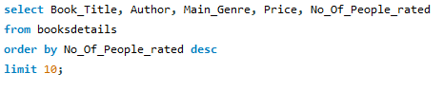
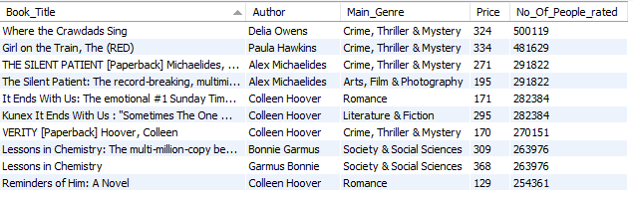
Top Selling Books
“Where the crowdads sing” by “Delia Owens is one of the top selling books which is rated by more the 500 thousands of the buyers on Amazon followed by the “Girl on the Train” and “The Silent Patient” which is rated by 480 and 290 thousands of the buyers respectively
Assuming more than 50% of the buyers who buy the books have rated on the site

Slide 7
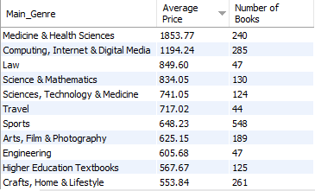
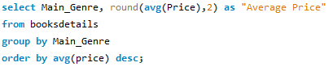
Average Price Across Genres
The average price of books within each genre can provide insights into pricing strategies and consumer preferences across different genres.
Here, Medicine & Health Science category tops the list with an average price of Rs.1850 despite of the lesser number of books on the website which determines most of the books are very high in cost.

Slide 8
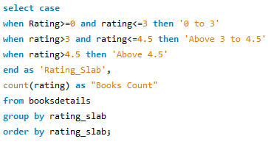
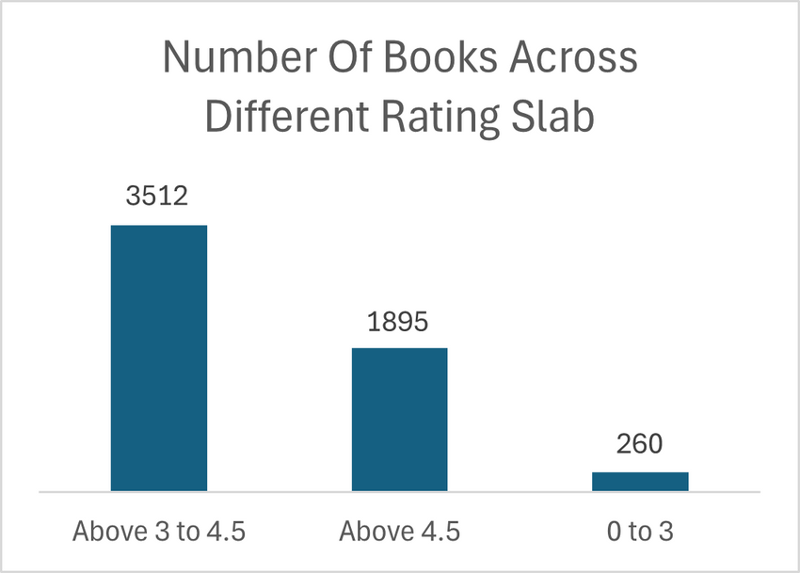
Distribution of Book Ratings
More than 3500 books are rated between 3 to 4.5 which is almost 62% of the overall, only 260 books are rated below 3 which is less than 5% and rest of the books are rated above 4.5

Slide 9
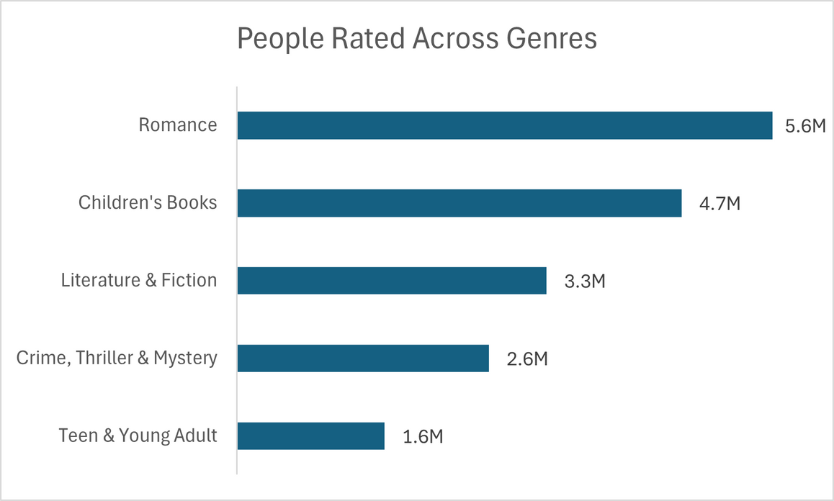
Genres with High Engagement
Recognizing books with a high number of people rated can indicate popularity and reader engagement, which are valuable metrics for publishers and authors.

Slide 10
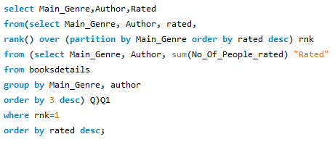
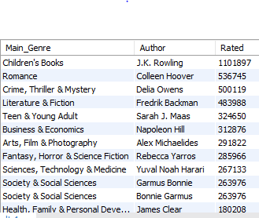
Genre Wise Top Authors
Authors based on the total number of books sold/ Number of people have rated within each genre can identify authors who are most successful in specific genres.
It will help in fostering author partnerships, curating genre-specific collections, and optimizing recommendations for readers interested in particular genres

Slide 11
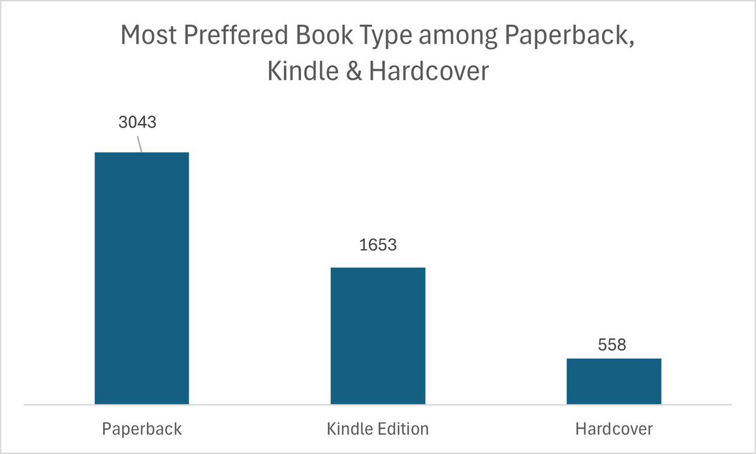
Most Preffered Book Type
Understanding the sales performance of different book types helps businesses to optimize inventory allocation, invest in formats that resonate with customers, and adapt distribution strategies to meet evolving consumer preferences.
Paperback has been the customers favorite among the top 3 book type available on Amazon followed by the Kindle Edition and Hardcover.

Slide 12
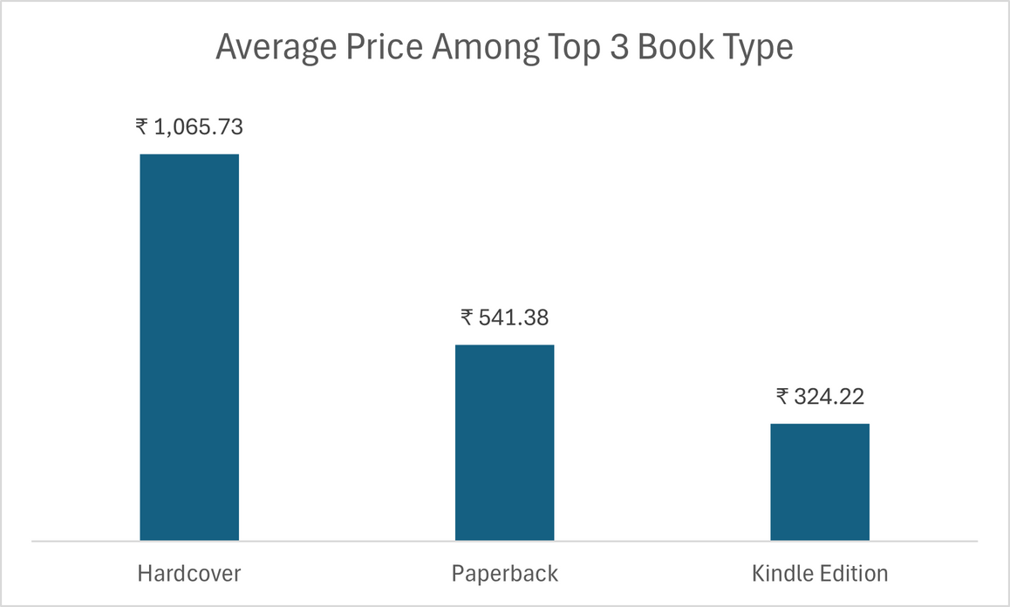
Average Price Distribution AcrossTop 3 Book Type
Hardcover is the costliest among the top 3 book type which effects on the lesser sales or not so preferred by the customers as we saw in the previous chart. Paperback is the most preferred physical copy of the books and after that people prefer the ebooks on Kindle.

Slide 13



Presented by Haider Ali
Thank you very much!
linkedin.com/in/haider-ali-5aa493124
haiderali.jnr@gmail.com

